Slide 1
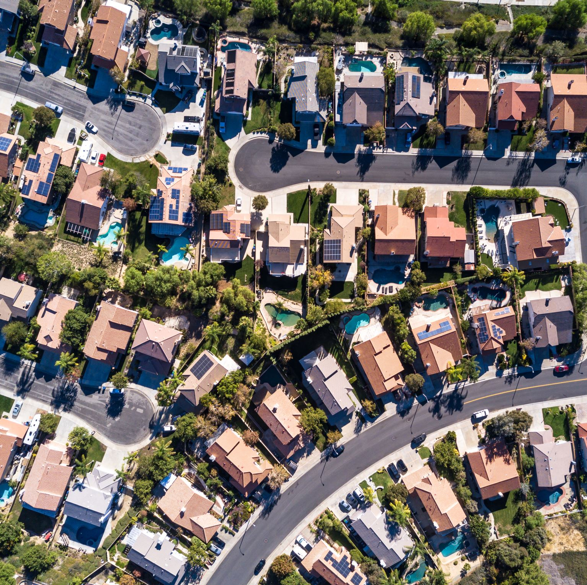
Predicting California Housing Prices
Daniel Pickett
December 2022

Slide 2
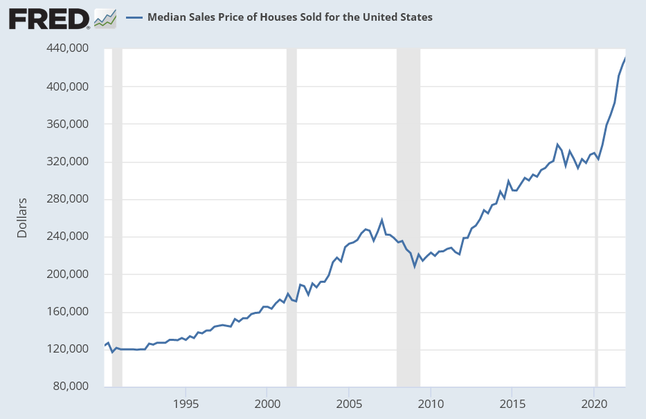
Problem context
US housing prices are increasingly a hot-button issue
California has among the most expensive in the nation
Some recent statistics¹:
Median US price, EOY 2016: $310,900
Median US price, EOY 2021: $423,600
Median CA price, EOY 2016: $485,000
Median CA price, EOY 2021: $692,500
¹ Source: https://fred.stlouisfed.org

Slide 3
Problem statement
Given a dataset on certain characteristics of houses in California, including their median price within a given block of houses, can we create a model to estimate California house value?

Slide 4



Who cares?
Real estate developers
Real estate investors
Anyone who is interested in the price of a house in California that may or may not yet be built
Personal homebuyers

Slide 5
About the data
20,640 records with 14 fields of data
Each record is a block of houses in California in 1990
Fields:
Location within California
House characteristics
Population characteristics
Relative distance from major features
Median house value: our dependent variable

Slide 6
Data wrangling
No mistyped data
No duplicate records
Numerous records with placeholders for missing values for independent variables
These values were imputed with their fields’ means
965 records with placeholders for missing values for the dependent variable
These records were removed from the data

Slide 7
Data wrangling (cont.)
All fields for house and population characteristics are right-skewed
No other immediately strange values or trends
Final data after wrangling: 19,675 records, all original 14 fields

Slide 8
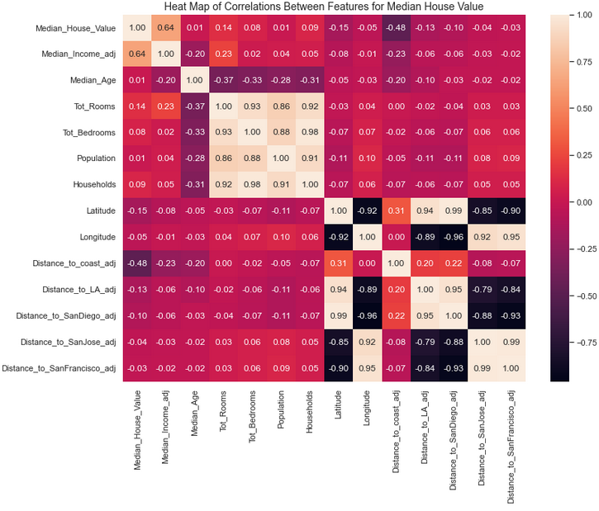
Exploratory data analysis
Heat map created to visualize correlations between fields
Only 2 fields had significant correlation with median house price:
Median income
Distance to coast

Slide 9
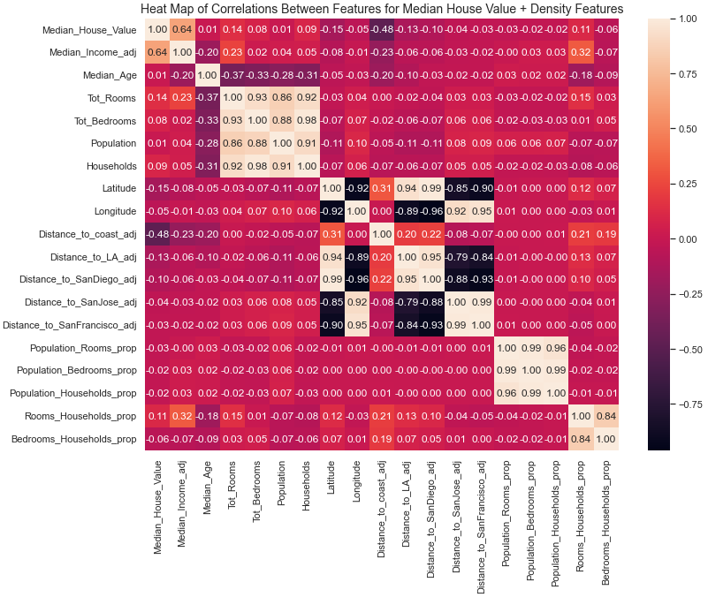
EDA (cont.)
Could density of rooms or population be correlated to price?
5 new density fields created:
Population per room
Population per bedroom
Population per household
Rooms per household
Bedrooms per household
Answer: no

Slide 10
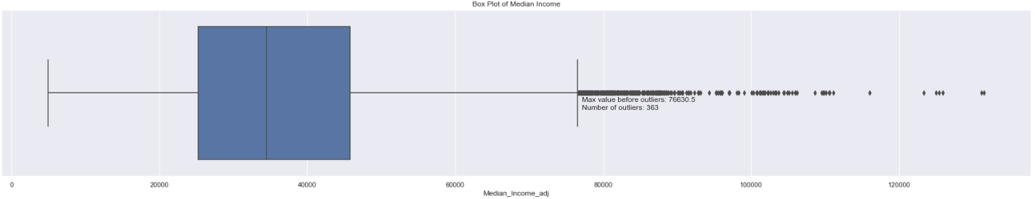
EDA (cont.)
Boxplots of each field created to visualize potential outliers
All fields appear to have positive outliers
However, we know all fields are skewed right
No action taken

Slide 11
Pre-processing the data
No fields are categorical – no transformation into dummy or indicator variables required
Most fields scaled to a range from 0 to 1
Data split into training and testing sets on 70/30 ratio
Final data after pre-processing:
X and y training sets: 13,772 records
X and y testing sets: 5,903 records
All sets use all original 14 fields

Slide 12
Modeling
The dependent variable, median house price, is presumably correlated to some combination of the other fields
The dependent variable is also continuous, not discrete or categorical
Attempt to fit a regression model

Slide 13
Modeling methodology
Choose model and define parameters
Fit model onto X and y training sets
Use model to predict y values from X testing set
Compare predicted y values against y training set
Calculate overall RMSE
Calculate individual differences

Slide 14
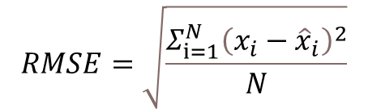
Modeling methodology - RMSE
Measures the average difference between each pair of actual/predicted values
The larger the RMSE, the less accurate the average prediction
$$RMSE=\sqrt{\frac{Σ_{ⅈ=1}^{N}{\left(x_{i}−{\hat{x}}_{i}\right)}^{2}}{N}}$$
N = # data points
x_{i} = actual value of observation i
x̂ _{i} = predicted value of observation i

Slide 15
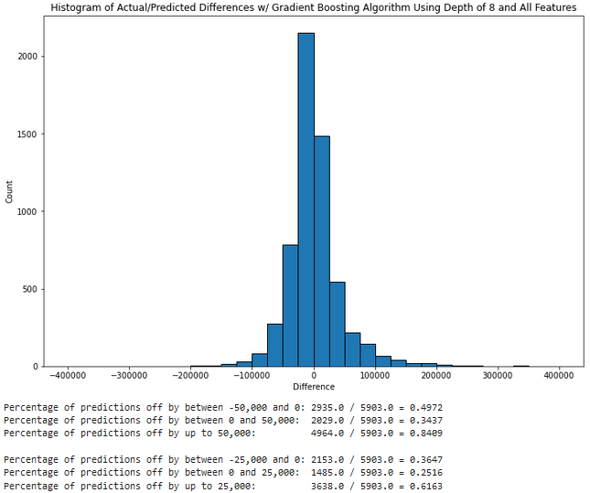
Modeling methodology - individual differences
Visualize the range of differences between actual/predicted values via histogram
Ballpark metrics for the differences:
“Good”: less than 50,000 difference
“Very good”: less than 25,000 difference
Calculate % of predictions within each metric

Slide 16
Models
First 4 models tested – linear regression:
Model 1: using all 13 dependent variables
Model 2: using the 2 significantly correlated dependent variables, median income and distance to coast
Model 3: using the 2 significantly correlated dependent variables, while also taking the log of distance to coast
Model 4: using the best K features as determined by SelectKBest algorithm

Slide 17
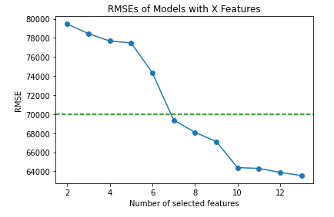
Model definition - SelectKBest
Algorithm that returns a model of best fit using the K best available features
K is a hyperparameter – a predetermined parameter that affects how the model builds itself on the data
Here, models with K values from 2 to 13 were built and their RMSE measured
K = 10 showed the last significant drop in error – further increased K would unnecessarily increase model complexity

Slide 18
Models (cont.)
Next 2 models tested – K-nearest neighbors:
Model 5: using the 2 significantly correlated dependent variables, median income and distance to coast
Model 6: using the best 10 features as determined by SelectKBest algorithm in Model 4

Slide 19
Model definition - K-nearest neighbors
Model that predicts values as the average value of the K records most similar to it (the neighbors)
K is a hyperparameter
Here, models with K values from 1 to 21 were built and their accuracy (coefficient of determination, R²) measured
Further increased K would not significantly increase accuracy, potentially overfit, and eventually drastically increase runtime
Highest accuracy for:
Model 5: K = 20
Model 6: K = 9

Slide 20
Models (cont.)
Last 3 models tested – decision trees:
Model 7: singular decision tree with K₁ depth
Model 8: random forest with K₂ depth
Model 9: gradient-boosted trees with K₃ depth

Slide 21
Model definitions - decision trees
Decision tree:
A model that groups similar values based on a series of binary combinations of characteristics…
…then predicts new values as the average value of the records in the group it belongs to
Random forest: a model that averages many randomly adjusted decision trees – this generally decreases variance
Gradient boosting: a model that iterates and improves off of previously built versions of itself

Slide 22
Model definition – decision tree depth
Each tree has a maximum depth K that limits how specific its binary combinations can become
K is a hyperparameter
Here, models with K values from 3 to 21 were built and their accuracy (coefficient of determination, R²) measured
Further increased K would not significantly increase accuracy, potentially overfit, and eventually drastically increase runtime
Highest accuracy for:
Model 7: K = 10
Model 8: K = 15
Model 9: K = 8

Slide 23
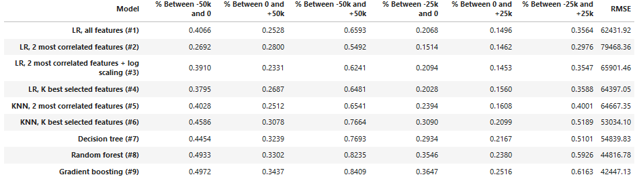
Results
Compiled results, by model number:

Slide 24
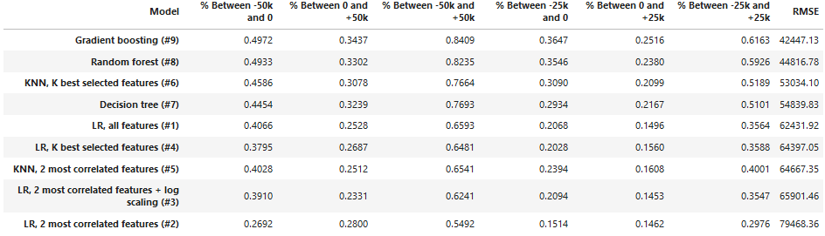
Results (cont.)
Compiled results, by RMSE:

Slide 25
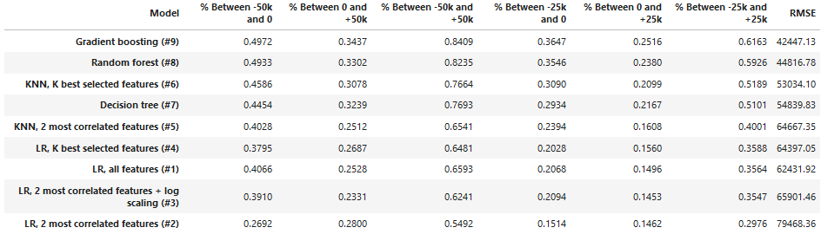
Results (cont.)
Compiled results, by % predictions differing by at most 25,000:

Slide 26
Conclusion
Gradient-boosted tree and random forest models (#9 and #8) have the lowest RMSEs and highest % predictions meeting ballpark metrics
For both models, ~60% predictions are within 25,000 and over 80% are within 50,000
Both of these models are the most complex, automatically determining the best features/parameters and accounting for error from weaker iterations
Linear regression models (#1-4) have the highest RMSEs and lowest % predictions
These models were mostly built from manually selected features, and attempt to fit a line on largely non-linear results
Final model choice: model #9 – gradient-boosted tree

Slide 27
Notes for future research
Wider selection of dependent variables would have likely helped achieve better predictions, and understand conceptually why they are more accurate
For example, median square footage could have led to creating a more correlated density field
Gathering/scraping additional data on a house-block basis was not feasible – consider future datasets with more accessible record definitions
A more modern dataset would obviously create a model more usable today
Could this type of model be applied to other states (after adjusting for state-specific features)?

